Slide 1


Big Data Seminar – BIA 678
Big Data Analytics - Recommenders
David Belanger PhD
Senior Research Fellow – Stevens Institute of Technology
dbelange@stevens.edu
http://www.examiner.com/images/blog/EXID1827/images/shamrock.jpg

Slide 2
Class 12 – Analytics I– Outline Occam’s Razor “Everything Should Be As Simple As Possible, But Not Simpler” – Albert Einstein
Administrative Stuff:
Team Project Questions
Assignment #1– Readings on big data Analytics
Classification: A Comparative Study of Collaborative Filtering Algorithms, Lee, Sun, Lebanon, 2012
A Survey of Collaborative Filtering Techniques : Su & Khoshgoftaar: on canvas
Activity #1 – Lecture for Analytics I
Assignment :
“A Brief Introduction to Boosting” Rob Schipire, http://rob.schapire.net/papers/Schapire99c.pdf
“XGBoost: A Scalable Tree Boosting System:”, Chen and Guestrin, https://arxiv.org/pdf/1603.02754.pdf,
Source #1 - www.tableau.com/academic

Slide 3
Class 10+ Looking Ahead
Analytics:
“XGBoost: A Scalable Tree Boosting System:”, Chen and Guestrin, https://arxiv.org/pdf/1603.02754.pdf,
http://www.di.unipi.it/~cardillo/AA0304/fabio/boosting.pdf
A Decision theoretic generalization of on-line learning and application to boosting, Freund and Schapire https://cseweb.ucsd.edu/~yfreund/papers/adaboost.pdf
Thomas Wedell-Wedellsborg, Are You Solving the Right Problems, Harvard Business Review, Jan-Feb 2017
Visualization:
Shneiderman, Ben, Extreme Visualization: Squeezing a Billion Records into a Million Pixels http://www.cs.umd.edu/~ben/papers/Shneiderman2008Extreme.pdf
Nanocubes for Real-Time Exploration of Spatiotemporal Datasets Lauro Lins, James T. Klosowski, and Carlos Scheidegger; http://nanocubes.net/assets/pdf/nanocubes_paper.pdf , + http://www.nanocubes.net/ for demos and open source.
A possibly useful dataset:
http://grouplens.org/datasets/movielens/ - Do a SVD Recommender for the smaller dataset, using Python or Java or R.
Security, Privacy, etc.
Verizon Data Breach Digest 2017 (on CANVAS)
Article 29 Data Protection Working Party (Section 3 & Annex) (on CANVAS)

Slide 4
Parallelization – Map/Reduce Theorems
Valiant Theorem
Kearns – Statistical Query Model

Slide 5
Valiant Model [Valiant’84]
x is the input
y is a function of x that we want to learn
In Valiant model, the learning algorithm uses randomly drawn examples <x, y> to learn the target function
eecs.wsu.edu/~cook/.../presentations/inna.ppt

Slide 6
Statistical Query Model [Kearns’98]
A restriction on Valiant model
A learning algorithm uses some aggregates over the examples, not the individual examples
Given a function f(x,y) over instances (data points x and labels y), a statistical oracle will return an estimate of the expectation of f(x,y)
Any model that computes gradients or sufficient statistics over f(x,y) ﬁts this model
Typically this is achieved by summing over the data.
eecs.wsu.edu/~cook/.../presentations/inna.ppt

Slide 7
Summation Form
Aggregate over the data:
Divide the data set into pieces
Compute aggregates on each cores
Combine all results at the end
eecs.wsu.edu/~cook/.../presentations/inna.ppt

Slide 8


Example: Linear Regression
Model:
Goal:
Solution: Given m examples: (x₁, y₁), (x₂, y₂), …, (x_{m}, y_{m}) We write a matrix X with x₁, …, x_{m} as rows, and row vector Y=(y₁, y₂, …y_{m}). Then the solution is
Parallel computation:
eecs.wsu.edu/~cook/.../presentations/inna.ppt

Slide 9
Naïve Bayes (NB)
Goal: estimate P(x_{j}=k|y=1) and P(x_{j}=k|y=0) and P(y)
Computation: count the occurrence of (x_{j}=k, y=1) and (x_{j}=k, y=0), count the occurrence of (y=1) and (y=0)
Mappers: count a subgroup of training samples
Reducer: aggregate the intermediate counts, and calculate the final result
eecs.wsu.edu/~cook/.../presentations/inna.ppt

Slide 10
K-means
Computing the Euclidean distance between sample vectors and centroids
Recalculating the centroids
Divide the computation to subgroups to be handled by map-reduce
eecs.wsu.edu/~cook/.../presentations/inna.ppt

Slide 11
Principal Components Analysis (PCA)
Compute the principle eigenvectors of the covariance matrix
Clearly, we can compute the summation form using map-reduce
Express the mean vector as a sum
eecs.wsu.edu/~cook/.../presentations/inna.ppt

Slide 12
Other Algorithms
Logistic Regression
Independent Component Analysis
Support Vector Machine
Expectation Maximization (EM)
eecs.wsu.edu/~cook/.../presentations/inna.ppt

Slide 13
Time Complexity
Basically: Linear speed up with increasing number of cores
eecs.wsu.edu/~cook/.../presentations/inna.ppt

Slide 14
Setup
Compare map-reduce version and sequential version
10 data sets
Machines:
Dual-processor Pentium-III 700MHz, 1GB RAM
16-way Sun Enterprise 6000
eecs.wsu.edu/~cook/.../presentations/inna.ppt

Slide 15
Dual-Processor SpeedUps
eecs.wsu.edu/~cook/.../presentations/inna.ppt

Slide 16
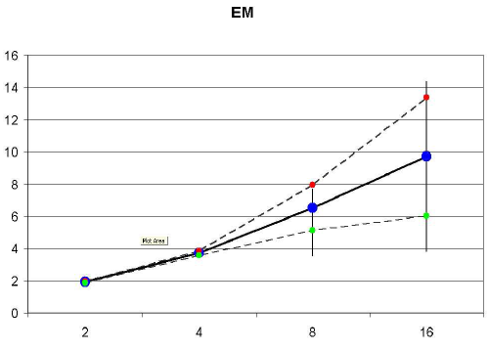
SpeedUp for 2-16 processors
Bold – average
Error Bars – max/min
Dashed - variance
eecs.wsu.edu/~cook/.../presentations/inna.ppt

Slide 17
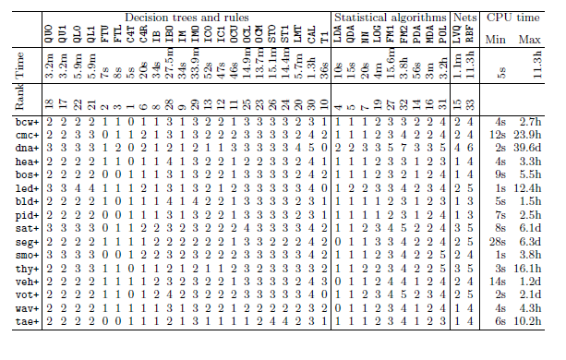

Slide 18
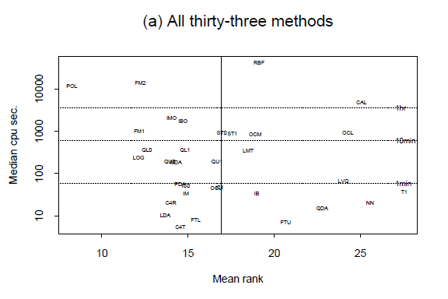

Slide 19
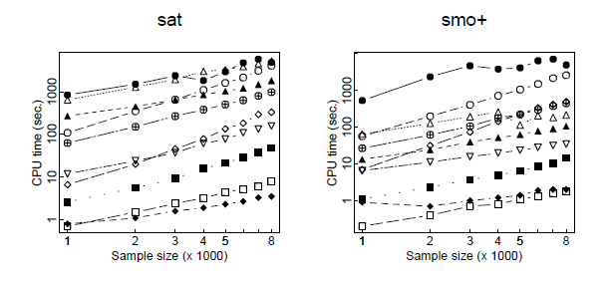
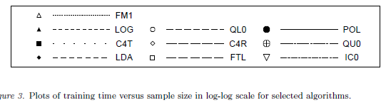

Slide 20
Impact of Scale: A Example of Classification Performance Results #3 Study by: Prashanth Ashok Ramkumar, Ram Kharawala, Qing Wei

Slide 21

Recommendation systems
Can we recommend books, films, products to users
based on their personal tastes?

Slide 22


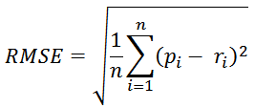
2008: Factorization meets the neighborhood: a multifaceted collaborative filtering model, Y. Koren, ACM SIGKDD
Stimulated by work on Netflix competition
Prize of $1,000,000 for accuracy improvement of 10% RMSE compared to own Cinematch system
Very large dataset (~100M ratings, ~480K users , ~18K movies)
Last ratings/user withheld (set K)
Root mean squared error metric optimized to 0.8567
Metrics measure error rate
Mean Absolute Error (MAE) computes the deviation between predicted ratings and actual ratings
Root Mean Square Error (RMSE) is similar to MAE, but places more emphasis on larger deviation

Slide 23
2008: Factorization meets the neighborhood: a multifaceted collaborative filtering model, Y. Koren, ACM SIGKDD
Merges neighborhood models with latent factor models
Latent factor models
good to capture weak signals in the overall data
Neighborhood models
good at detecting strong relationships between close items
Combination in one prediction single function
Local search method such as stochastic gradient descent to determine parameters
Add penalty for high values to avoid over-fitting

Slide 24
Recommendation systems
Can we recommend books, films, products to users
based on their personal tastes?
Common Approaches:
Content Filtering
Collaborative Filtering
Memory Based Algorithms
Model Based Algorithms

Slide 25
Content-based filtering
Extract features from content






actors
director
genre
keywords in plot summary
etc.

Find nearest ­neighbours to what a user
likes or buys

Slide 26
Content-based filtering
Positives
Rate New Items
No Herding
No User Information Exposed
Negatives
Features may not be relavent
Recommendations may be boring
Feature “bubble”


Slide 27
Collaborative Filtering
Features are user/item interactions
Purchases
Explicit ratings
Need lots of cleanup
Scaling
User/User Filtering, find common users
Suggest users with similar tastes
Item/Item Filtering, find similar items
Suggest similar items


Slide 28
Collaborative Filtering
Positives
Automatic Feature Extraction
Surprising Recommendations
Negatives
Ratings for new users/items
Herding
Privacy


Slide 29
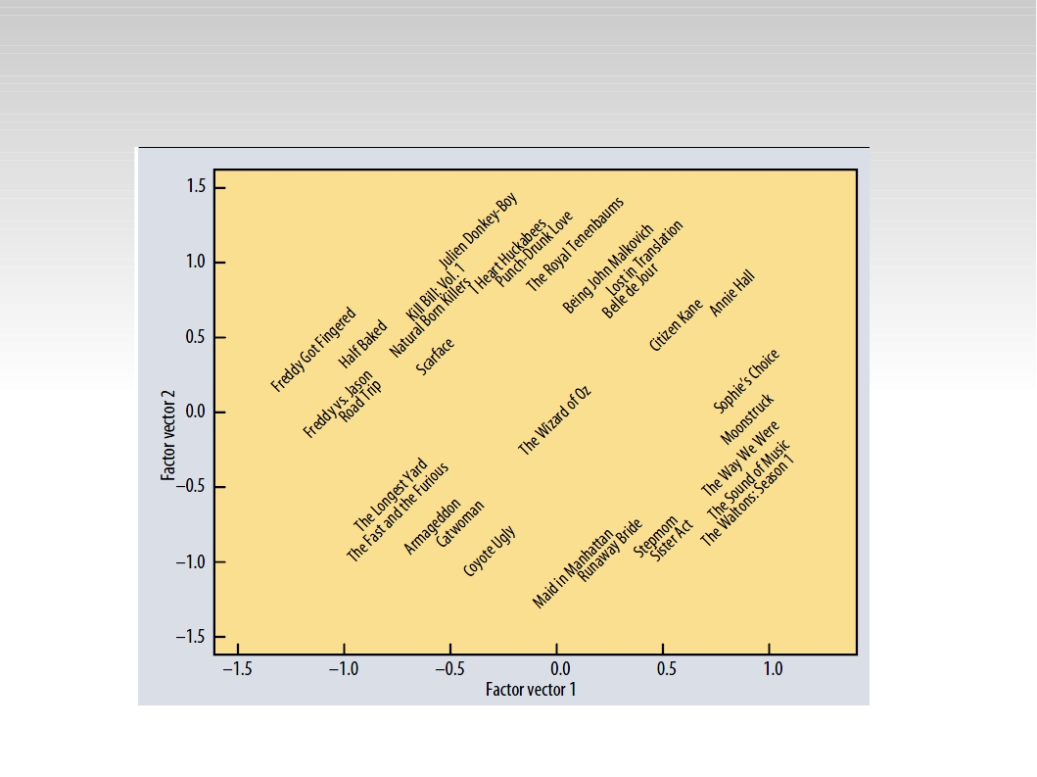
Item-item filtering preferred
Koren, Bell, Volinksy, 2009

Slide 30

The Netflix Prize, 2006-2009
100M film ratings made available

480k users
17k films
(shoddily) anonymised



3M ratings held in reserve

goal: improve predictions by 10%
measure by RMS error


US $1 M prize

attracted over 2500 teams


Slide 31
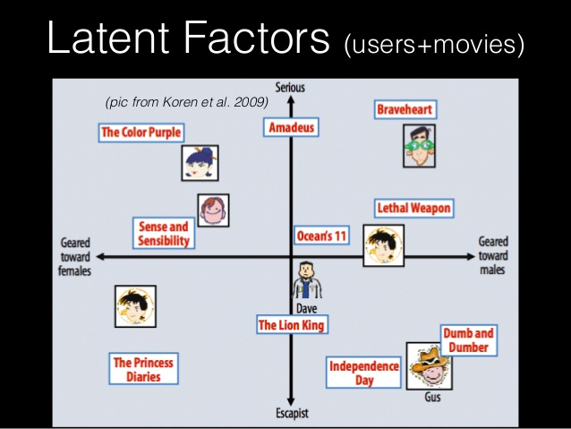

Slide 32
CF categories | Representative techniques | Main advantages | Main shortcomings
Memory-based CF | Neighbor-based CF (Item-based/user-based CF algorithms with Pearson/vector cosine correlation) Item-based/user-based top-N recommendations | Easy implementation New data can be add easily and incrementally Need not consider the content of the items being recommended Scale well with co-rated items | Dependent on human ratings Performance decrease when data are sparse Cannot recommend for new users and items Have limited scalability for large datasets
Model-based CF | Bayesian belief nets CF Clustering CF MDP-based CF Latent semantic CF Sparse factor analysis CF using dimensionality Reduction techniques, for example SVD, PCA | Better address the sparsity, scalability and other problems Improve prediction performance Give an intuitive rationale for recommendations | Expensive model-building Have trade-off between prediction performance and scalability Lose useful information for dimensionality reduction techniques
Hybrid recommenders | Content-based CF recommender for example, Fab Content-boost CF Hybrid CF combing memory-based CF algorithm, for example personality Diagnosis | Overcome limitations of CF and content-based or other recommenders Improve prediction performance Overcome CF problems such as sparsity and gray sheep | Have increased complexity and expense for implementation Need external information that usually not available
Notes:
Grey sheep :孤独用户的存在问题

Slide 33
Recommender Systems
Memory Based Algorithms:
Goal: Find Users that are “similar” to other users, and use them to recommend items.
Find users who variations from their “average” ratings are similar.
Common “Similarity” Measures
Pearson Correlation Coeficient
Cosine Distance Measure.


Slide 34
Collaborative Filtering
Input: Matrix of User/Item Ratings
Often modified to reflect deviations for user’s average ratings.
Goal: A numeric prediction of the extent to which a user will like a given item. Hence a recommendation for the items most likely to be “liked” be the user.
Approaches:
User Based
Item Based
Common Similarity Measures:
Pearson Correlation Coefficient
Cosine Similarity Measure


Slide 35
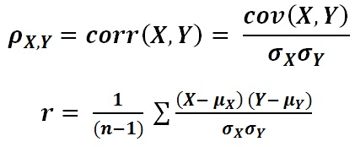
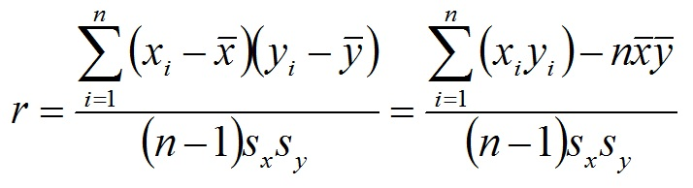
Memory Based, Collaborative Filtering
Pearson Correlation Coefficient
Create Matrix of deviation from average for each user.
Calculate Correlation Matrix


Slide 36

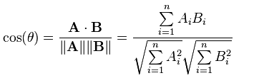
Memory Based, Collaborative Filtering
Cosine Similarity Measure
Create Matrix of deviation from average for each user.
Calculate Cosine Distances

Cosine Distance (A,B) = 1 – Cosine Similarity (A.B)

Slide 37
User-based nearest-neighbor collaborative filtering
Approach:
Create a rating for an active user and an item not yet seen.
Find a set of users (nearest neighbors) who liked the same items as the given user in the past and who have rated the item in question.
That is, create a similarity score between the target user and all other users
Do this for all of the items missing from the target user’s row, and recommend the highest rated.
Some implicit assumptions:
Target’s preferences remain stable over time.

Slide 38
User-based nearest-neighbor collaborative filtering (2)
Example
A database of ratings of the current user, Target, and some other users is given:
Determine whether Target will like or dislike Item5, which he/she has not yet rated or seen
See Spreadsheet
 | Item1 | Item2 | Item3 | Item4 | Item5
Target | 5 | 3 | 4 | 4 | ?
User1 | 3 | 1 | 2 | 3 | 3
User2 | 4 | 3 | 4 | 3 | 5
User3 | 3 | 3 | 1 | 5 | 4
User4 | 1 | 5 | 5 | 2 | 1

Slide 39
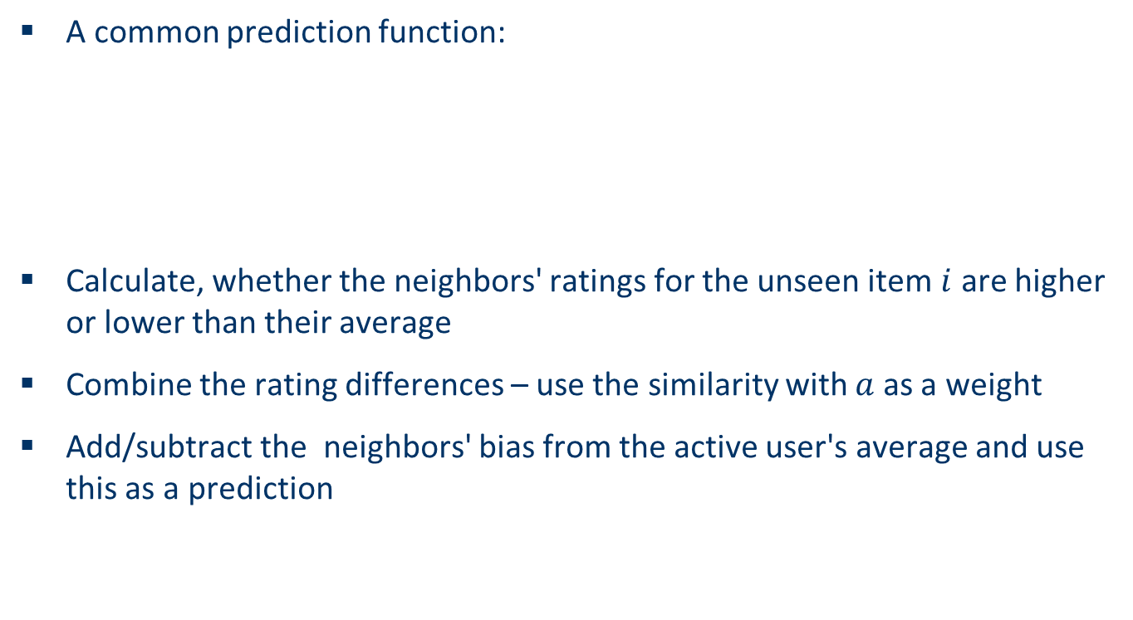
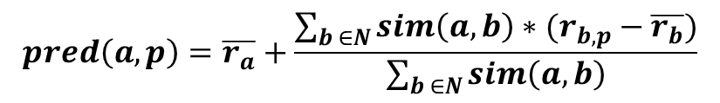
Making predictions
Source: Collaborative Filtering - David Breen, ICS.UCI.EDU

Slide 40
Improving the metrics / prediction function
Not all neighbor ratings might be equally "valuable"
Agreement on commonly liked items is not so informative as agreement on controversial items
Possible solution: Give more weight to items that have a higher variance
Value of number of co-rated items
Use "significance weighting", by e.g., linearly reducing the weight when the number of co-rated items is low
Case amplification
Intuition: Give more weight to "very similar" neighbors, i.e., where the similarity value is close to 1.
Neighborhood selection
Use similarity threshold or fixed number of neighbors
Source: Collaborative Filtering - David Breen, ICS.UCI.EDU

Slide 41
Memory-based and model-based approaches
User-based CF is said to be "memory-based"
the rating matrix is directly used to find neighbors / make predictions
does not scale for most real-world scenarios
large e-commerce sites have tens of millions of customers and millions of items
Model-based approaches
based on an offline pre-processing or "model-learning" phase
at run-time, only the learned model is used to make predictions
models are updated / re-trained periodically
large variety of techniques used
model-building and updating can be computationally expensive
item-based CF is an example for model-based approaches

Slide 42
Item-based collaborative filtering
Basic idea:
Use the similarity between items (and not users) to make predictions
Example:
 | Item1 | Item2 | Item3 | Item4 | Item5
Target | 5 | 3 | 4 | 4 | ?
User1 | 3 | 1 | 2 | 3 | 3
User2 | 4 | 3 | 4 | 3 | 5
User3 | 3 | 3 | 1 | 5 | 4
User4 | 1 | 5 | 5 | 2 | 1

Slide 43
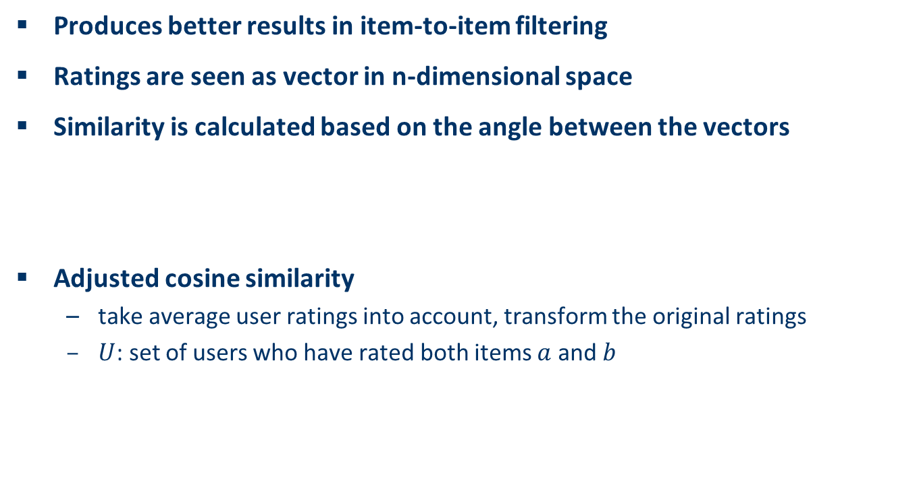
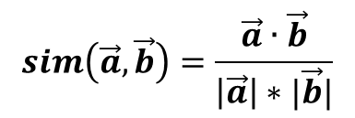
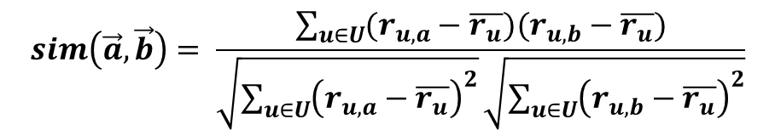
The cosine similarity measure
Source: Collaborative Filtering - David Breen, ICS.UCI.EDU

Slide 44
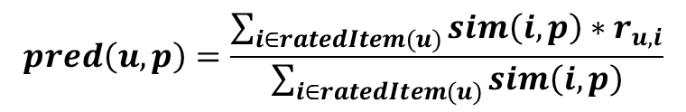
Making predictions
A common prediction function:
Neighborhood size is typically also limited to a specific size
Not all neighbors are taken into account for the prediction
An analysis of the MovieLens dataset indicates that "in most real-world situations, a neighborhood of 20 to 50 neighbors seems reasonable" (Herlocker et al. 2002)
Source: Collaborative Filtering - David Breen, ICS.UCI.EDU

Slide 45
Pre-processing for item-based filtering
Item-based filtering does not solve the scalability problem itself
Pre-processing approach by Amazon.com (in 2003)
Calculate all pair-wise item similarities in advance
The neighborhood to be used at run-time is typically rather small, because only items are taken into account which the user has rated
Item similarities are supposed to be more stable than user similarities
Memory requirements
Up to N² pair-wise similarities to be memorized (N = number of items) in theory
In practice, this is significantly lower (items with no co-ratings)
Further reductions possible
Minimum threshold for co-ratings
Limit the neighborhood size (might affect recommendation accuracy)
Source: Collaborative Filtering - David Breen, ICS.UCI.EDU

Slide 46
Model-based approaches
Advantages:
Scalability
Faster given preprocessed models
Avoidance of Overfitting
Drawbacks:
Time to create models

Slide 47
Model-based approaches (Generally Item based due to scale)
Plethora of different techniques proposed in the last years, e.g.,
Matrix factorization techniques, statistics
singular value decomposition, principal component analysis
Association rule mining
compare: shopping basket analysis
Probabilistic models
clustering models, Bayesian networks, probabilistic Latent Semantic Analysis
Various other machine learning approaches
Costs of pre-processing

Slide 48
Dimension Reduction
(aka Matrix Factorization Techniques)
PCA and SVD
PCA: Principle Components Analysis.
SVD: Singular Value Decomposition.
SVD and PCA are closely related.
Why we use SVD and PCA?
• A powerful tool for analyzing data and finding patterns.
• Used for compression. So you can reduce the number of
dimensions without much loss of information.
IyadBatal

Slide 49
PCA
Objective: project the data onto a lower dimensional linear space
such that the variance of the projected data is maximized.
Equivalently, it is the linear projection that minimizes the average
projection cost (mean squared distance between the data points and
their projections).
Different from the feature subset selection !!!
Problem to solve: In high dimensional space, we need to learn a large
number of parameters. Thus if the dataset is small, this will result in
large variance and over-fitting.
We want to represent the vector x in a different space (p dimensional)
using a set of orthonormal vectors U (where uiis a principle
component).
IyadBatal

Slide 50
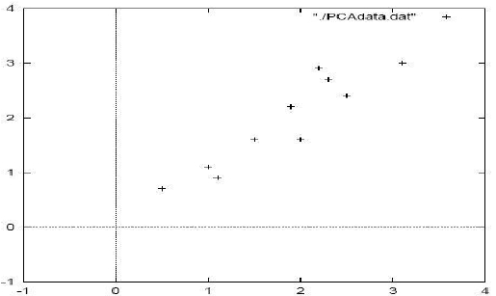
PCA
Method to perform PCA
➢ Step 1: get some data
LetA(N,n) be the data matrix: N is the number of data points, n is the
number of dimensions. It could represent N patients with n numerical
symptoms each (blood pressure, cholesterol level etc) or N documents
with n terms in each document (used in IR).
IyadBatal

Slide 51

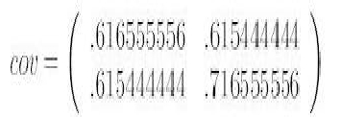
PCA
Method to perform PCA
➢ Step 2: Subtract the mean
Intuitively, we translate the origin to the center of gravity. We obtain the
matrix B (N,n):
This produces a zero mean data (the column averages are zero).
➢ Step 3: Calculate the covariance matrix C.
C(n,n)= [B^{T}(n,N) x B(N,n) ]: T is transpose.
Since our data is 2D, the covariance matrix will be (2 x 2).
Notice that the non-diagonal elements are positive, why?
IyadBatal

Slide 52
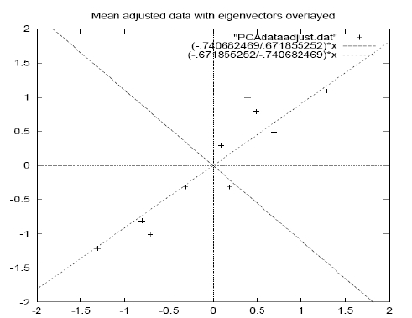
PCA
Method to perform PCA
➢ Step 4: Calculate the eigenvectors and eigenvalues of the covariance matrix
Since the covariance matrix is square, we can calculate the eigenvectors
λ1≈1.28, V1 ≈ [-0.677 -0.735]^{T} , λ2 ≈0.49, V2 ≈ [-0.735 0.677]^{T}
Notice that V1 and V2
Are orthonormal, why?
V1 . V2 = 0
|V1|=1
|V2|=1
IyadBatal

Slide 53
PCA
Method to perform PCA
➢ Step 5: Choosing components and forming a feature vector
Objective: project the n dimensional data on a p dimensional sub-
space (p ≤ n), minimizing the error of the projections(sum of
squared difference).
Here is where we reduce the dimensionality of the data (for example,
to do compression).
How: Order the eigenvalues from highest to lowest to get the
components in order of significance. Project on the p eigenvectors
that corresponds to the highest p eigenvalues.
IyadBatal

Slide 54
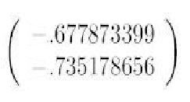
PCA
Method to perform PCA
➢ Step 5 (continue)
The eigenvector with the highest eigenvalue is the principle
component of the data.
if we are allowed to pick only one dimension to project the data on it,
then the principle component is the best direction.
the PC of our example is :
IyadBatal

Slide 55
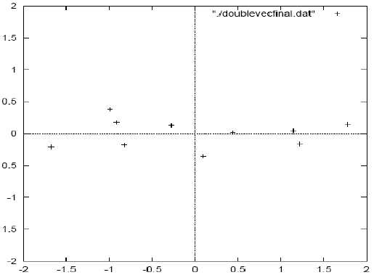
PCA
Method to perform PCA
➢ Step 6: Derive the new data set
Let’s denote Feature space matrix by U(n x p): where the columns are
the eigenvectors. Let the final data be F.
F(N,p)=B(N,n) x U(n,p)
The final data F resides
in a p-dimensional
feature space.
IyadBatal

Slide 56
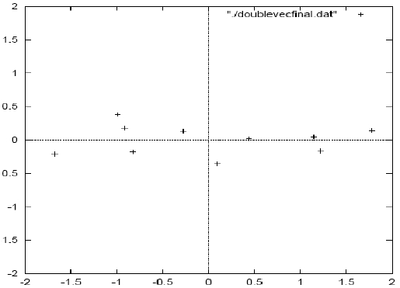
PCA
Method to perform PCA
➢ Step 6: (continue)
For our example, if we keep both eigenvectors, we get the original data,
rotated so that The eigenvectors are the axes. (we’ve lost no information)
IyadBatal

Slide 57
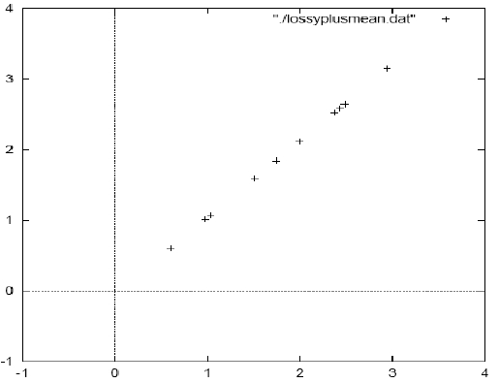
PCA
Method to perform PCA
➢ Step 7 (optional): getting the old data back. (if we are doing compression.)
If we keep all eigenvectors, we will get exactly the same data.
We know F=B x U
→B = F x U-1
→B = F x U^{T}
To get A, we add the mean to
vector to B.
Notice: The variance along the
Other Component has
gone (a lossy compression)
IyadBatal

Slide 58
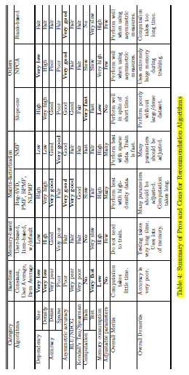
Comparison of CF Tools

Slide 59
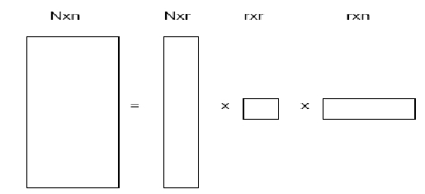
SVD
The eigenvalues and eigenvectors are defined for squared matrices.
For rectangular matrices, a closely related concept is Singular Value
Decomposition (SVD).
Theorem: Given an N x n real matrixA, we can express it as:
A= U xΛ x V^{T}
where U is a column-orthonormal N x r matrix, r is the rank of the
matrixA(number of linearly independent rows or columns),Λ is a
diagonal r x r matrix where the elements are sorted in descending
order, and V is a column-orthonormal n x r matrix.
SVD decomposition for a matrix is unique.
IyadBatal

Slide 60

SVD
The values of the diagonalΛ are called singular values. (we will see
later that they correspond to the square root of the eigenvalues of the
covariance matrix).
Theorem: the inverse of an orthonormal matrix is its transpose.
Proof: we know that
ThereforeA^{T}xA= I where I is the identity matrix.
From the definition ofA⁻¹ : A⁻¹ xA= I
→A⁻¹ =A^{T}
U^{T} x U = I and V^{T} x V = I
Also can be written using spectral decomposition as:
A= λ1U1 V1^{T} + λ2U2 V2 ^{T}+ … + λrUr Vr^{T}
IyadBatal

Slide 61
SVD
Theorem: if S is a real and symmetric (S=S^{T}) matrix then
S = U xΛ x UT. Where the columns of U are the eigenvectors, andΛ
is a diagonal matrix with values corresponding to eigenvalues.
Proof: let U be the matrix of eigenvectors placed in the columns:
U=[u1 u2 … un]
We can write: S x U=U xΛ
[S x u1 S x u2 … S x un]=[λ1.u1 λ2.u2 … λn.un] which is the definition
of the eigenvectors.
Therefore: S= U xΛ x U⁻¹
Because U is orthonormal → U⁻¹=U^{T}
→S = U xΛ x U^{T}
IyadBatal

Slide 62
The curse of dimensionality


Space is typically very sparse
Most dimensions are semantically useless

Hard for humans to tell which ones


